Slide 1
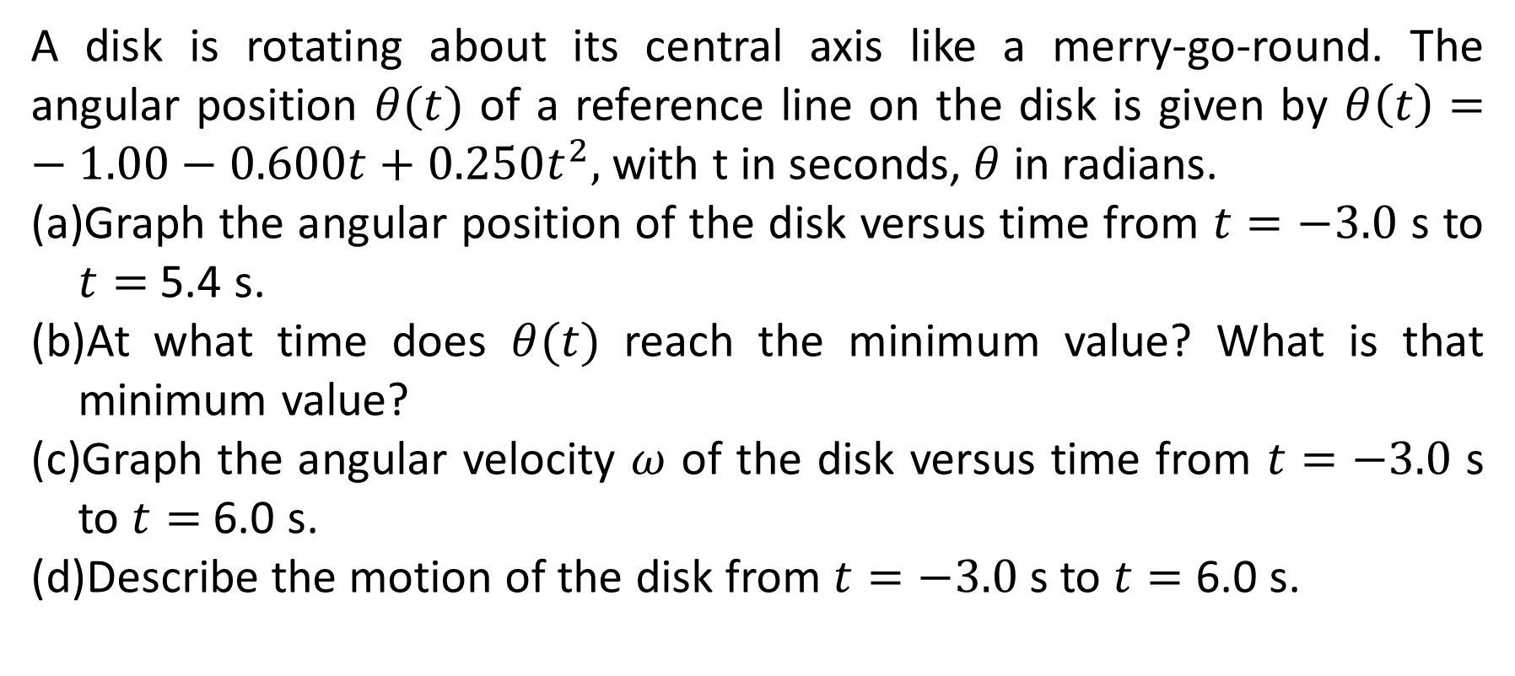
A disk is rotating about its central axis like a merry-go-round. The angular position $θ(t)$ of a reference line on the disk is given by $θ\left(t\right)=−1.00−0.600t+0.250t^{2},$ with t in seconds, $θ$ in radians.
Graph the angular position of the disk versus time from $t=−3.0$ s to $t=$ 5.4 s.
At what time does $θ(t)$ reach the minimum value? What is that minimum value?
Graph the angular velocity $ω$ of the disk versus time from $t=−3.0$ s to $t=$ 6.0 s.
Describe the motion of the disk from $t=−3.0$ s to $t=$ 6.0 s.

Slide 2
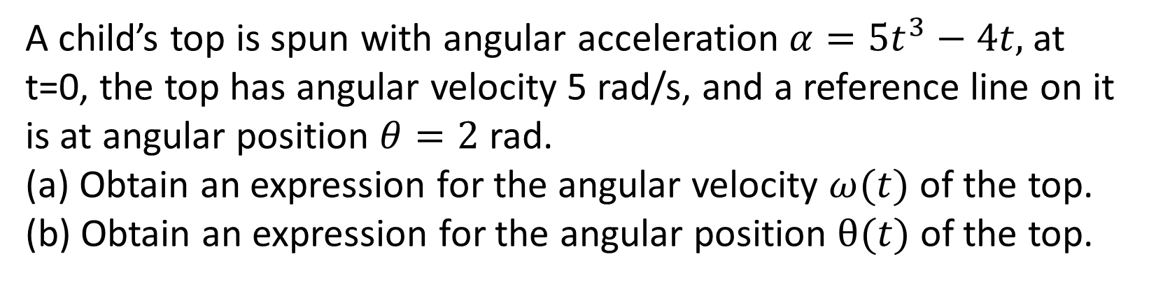
A child’s top is spun with angular acceleration $α=5t^{3}−4t,$ at t=0, the top has angular velocity 5 rad/s, and a reference line on it is at angular position $θ=2$ rad.
(a) Obtain an expression for the angular velocity $ω(t)$ of the top.
(b) Obtain an expression for the angular position $θ(t)$ of the top.

Slide 3
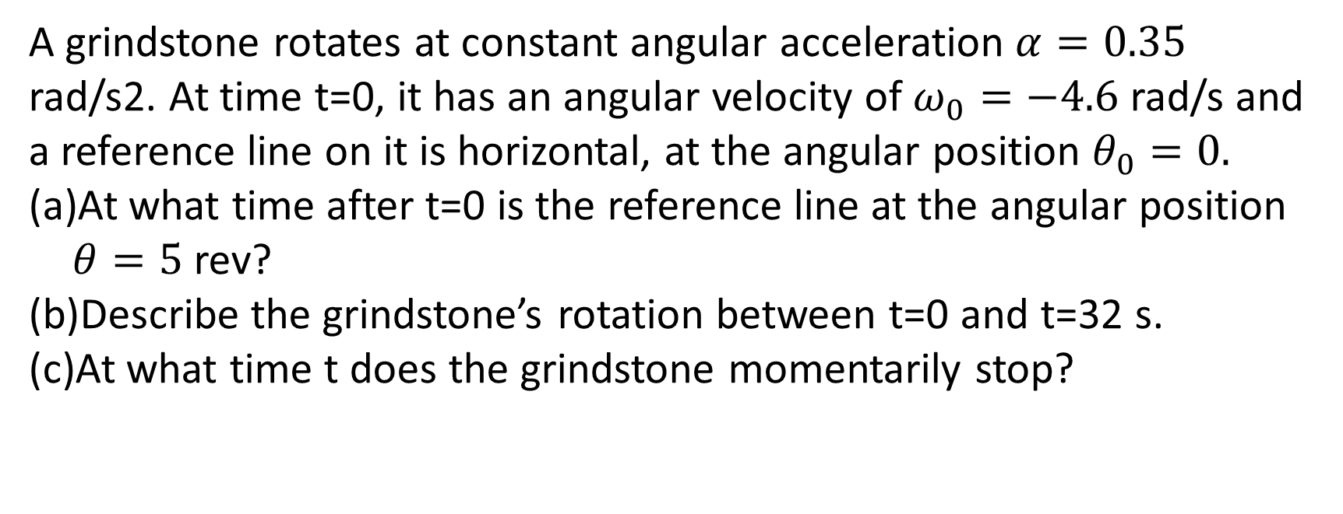
A grindstone rotates at constant angular acceleration $α=0.35$ rad/s2. At time t=0, it has an angular velocity of $ω_{0}=−4.6$ rad/s and a reference line on it is horizontal, at the angular position $θ_{0}=0.$
At what time after t=0 is the reference line at the angular position $θ=5$ rev?
Describe the grindstone’s rotation between t=0 and t=32 s.
At what time t does the grindstone momentarily stop?

Slide 4
Suppose the angular position of an object is given by Ɵ=6.39x10⁻²t³ what is the angular speed, linear speed, angular acceleration, tangential linear acceleration, radial acceleration, and acceleration of the object at t=2.20 s

Slide 5
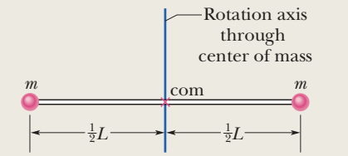
Figure shows a rigid body consisting of two particles of mass m connected by a rod of length L and negligible mass.
(a) What is the rotational inertia I_{com} about an axis through the center of mass perpendicular to the rod shown?
(b) What is the rotational inertia I of the body about an axis through the left end of the rod and parallel to the first axis.

Slide 6
A thin, uniform rod of mass M and length L, on an x axis with the origin at the rod’s center.
What is the rotational inertia of the rod about the perpendicular rotation axis through the center?
What is the rod’s rotational inertia I about a new rotation axis that is perpendicular to the rod and through the left end?

Slide 7
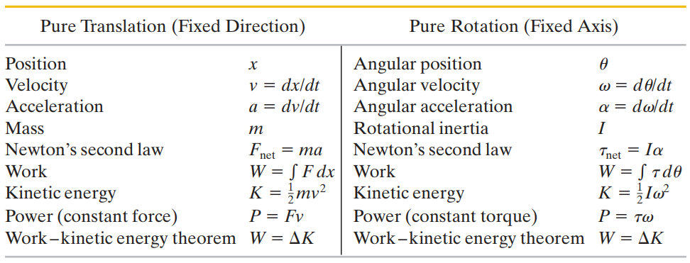

Slide 8
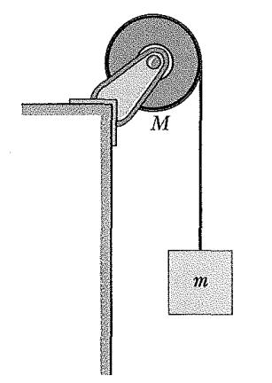
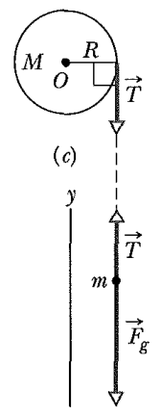
Figure shows a uniform disk, with mass M=2.5 kg and radius R=20 cm, mounted on a fixed horizontal axle. A block with mass m=1.2 kg hangs from a massless cord that is wrapped around the rim of the disk. Find the acceleration of the falling block, and the angular acceleration of the disk, and the tension of the cord. The cord does not slip, and there is no friction at the axle.
Let the disk in Fig. start from rest at time t= 0 and also let the tension in the massless cord be 6.0 N and the angular acceleration of the disk be -24 rad/s². What is its rotational kinetic energy K at t=2.5 s?

